Slide 1
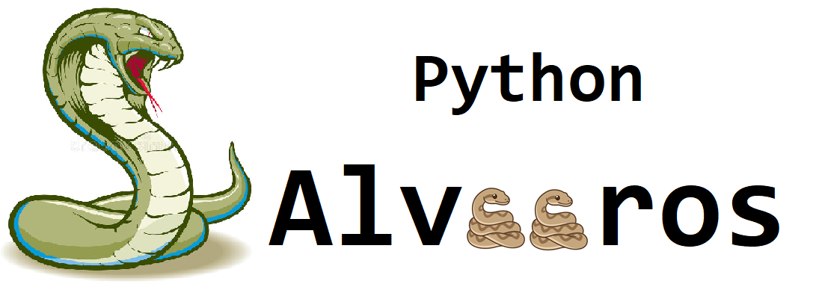

Handwritten Text Recognition project
Authors:
Michał Roguz, Kacper Goraj, Paweł Kosoń, Szymon Pawelec

Slide 2
The main objective
We’ve developed a fully operational software which task is to recognize handwritten samples of letters and digits from loaded images. It wasn’t such a piece of cake as it had seemed to us before. We’ve spent a wonderful time combining fun and work together. In addition, we’ve gained a lot experience and acquired many substantive values in various areas.

Slide 3
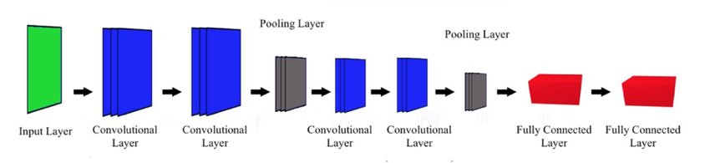
Model’s description
Our model’s working principle is based on Mini VGGNet. Its illustrative form is presented below.

Slide 4
Dataset: NIST Special Database 19
Special Database 19 contains NIST's entire corpus of training materials for handwritten document and character recognition. It publishes Handwritten Sample Forms from 3600 writers, 810,000 character images isolated from their forms, ground truth classifications for those images, reference forms for further data collection, and software utilities for image management and handling. We’ve chosen the data sorted by classes.

Slide 5
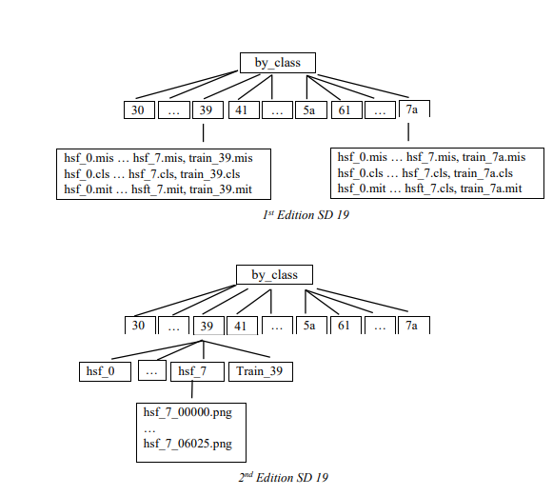
File hierarchies for by_class partition:

Slide 6
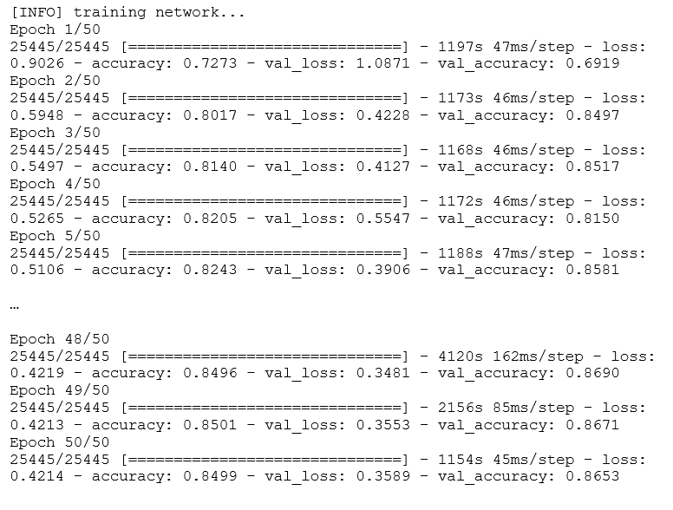
Training network

Slide 7
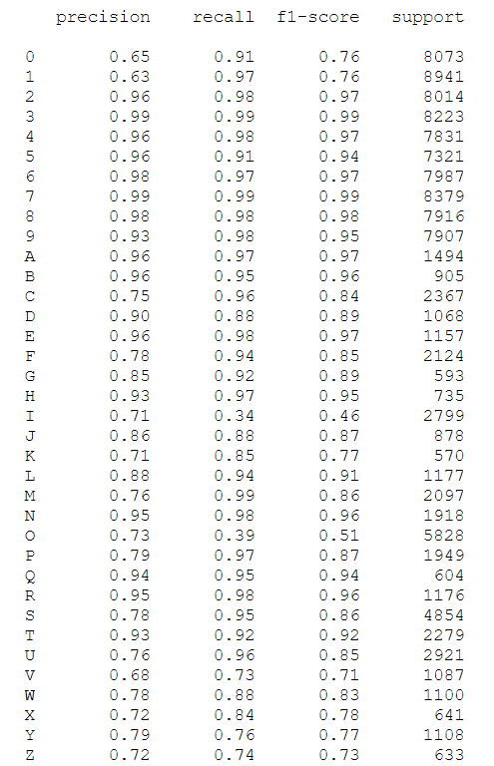
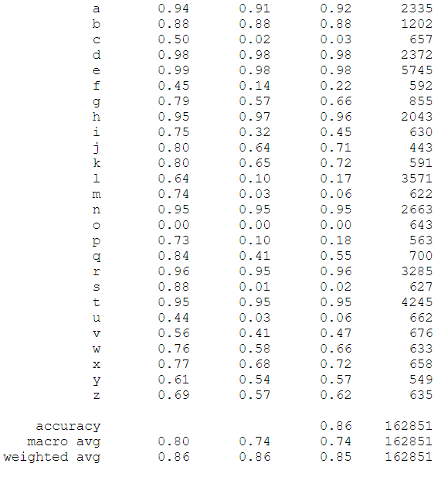
Training accuracy

Slide 8
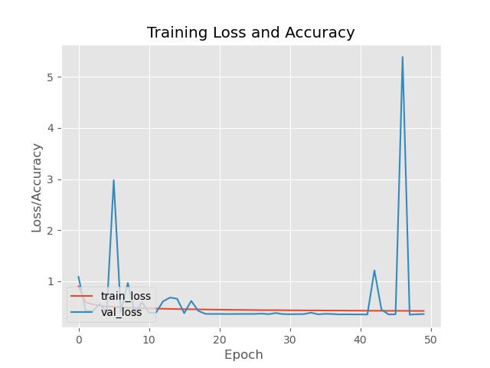

Slide 9
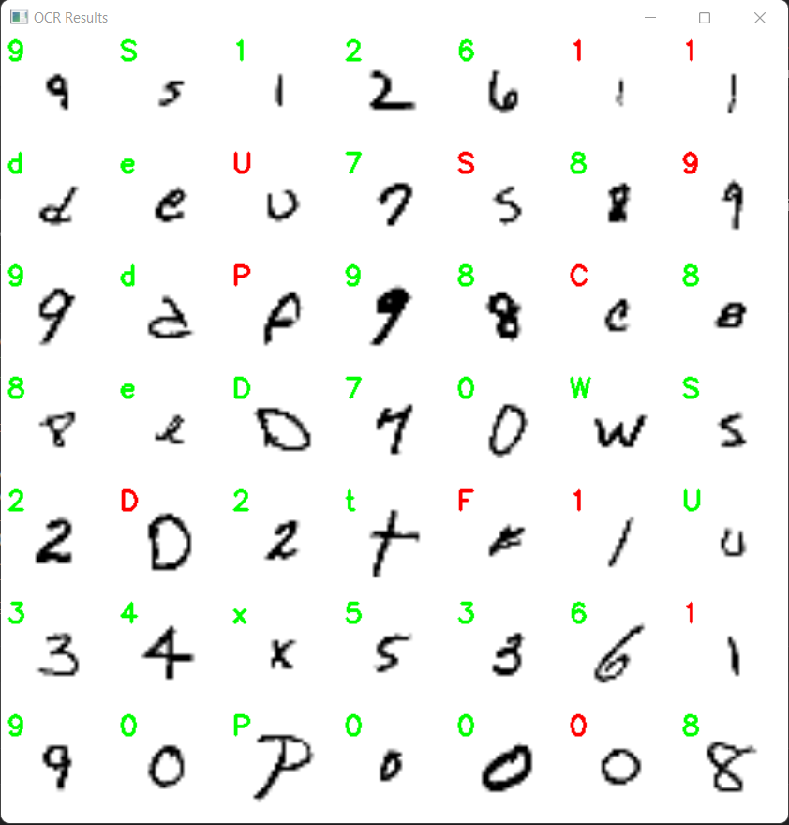
Testing the model

Slide 10
GUI
The graphical interface is user-friendly and includes:
the window where the scan is loaded
the "Load Scan" button that loads the image into the application
the "Recognise" button that recognizes the character in the image
the "Clear" button that clears the canvas with the scan
two windows showing the recognized character ("Recognized Text") and the accuracy of its recognition "(Accuracy")

Slide 11
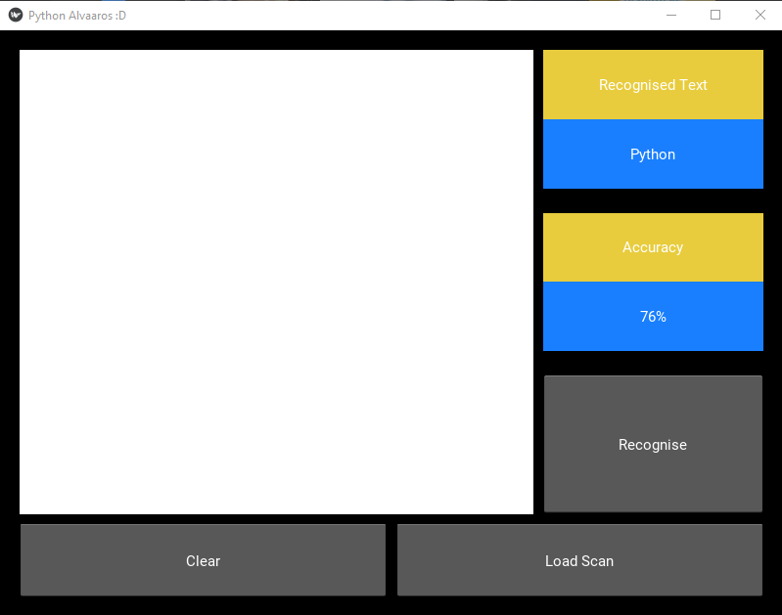
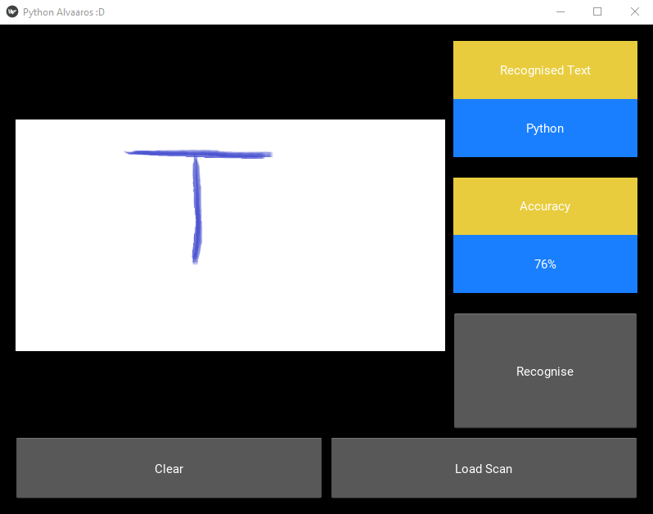
Start window
After load scan

Slide 12

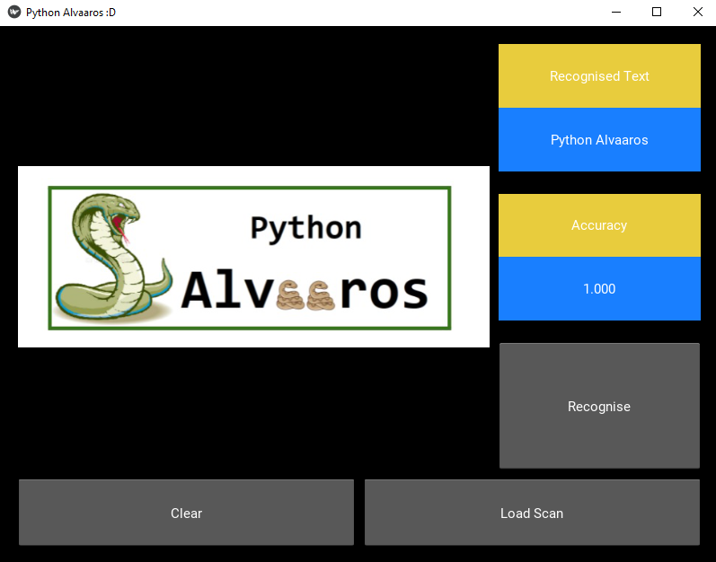
After recognition
After clear

Slide 13
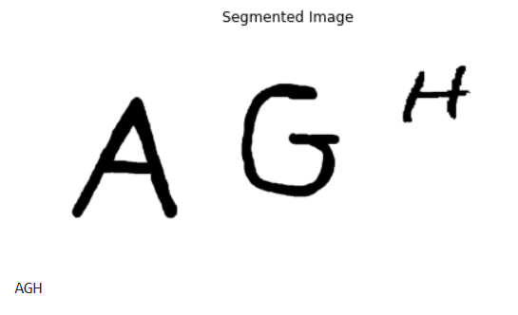
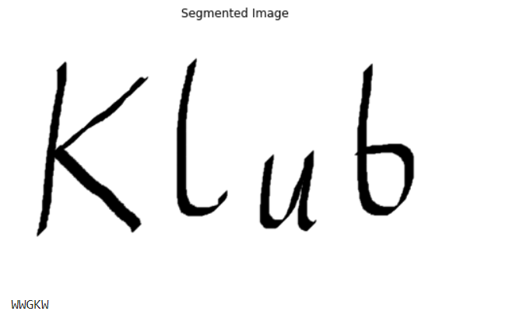
Attempts to recognize words
We’ve tried to add a functionality of recognizing individual letters from image. For that purpose we’ve created a function segmenting the photo. Unfortunately, in most cases the results were not satisfying, hence we’ve decided to keep the basic version.
Correct fit
Incorrect fit

Slide 14
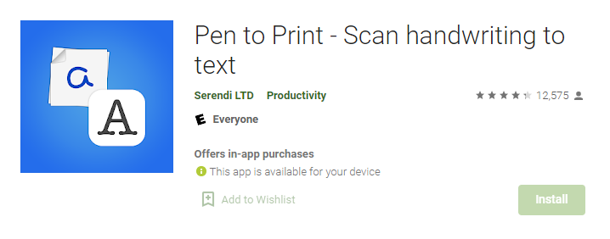
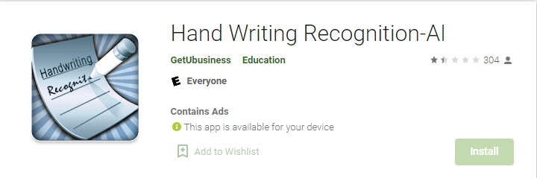
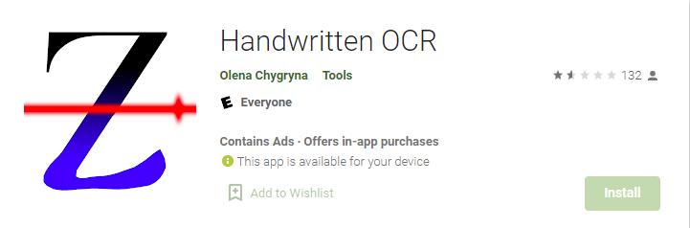
Similar apps
22PLN/month
quite expensive…
According to ratings it works even worse than badly…
4,79 PLN, but works pretty bad

Slide 15
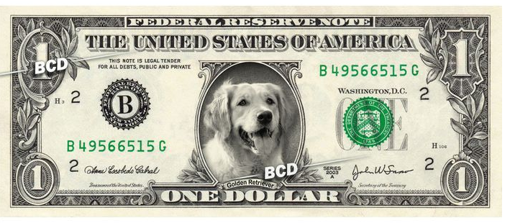
As we can see on the previous slide, of course there are some similar products on the market. But here comes the question- are they completely free of charge? In 90% cases the answer is unfortunately no, full functionalities are almost always available after additional payments. Hence, the biggest advantage of our app is its price- 0$… It’s a real bargain and great value for money.

Slide 16
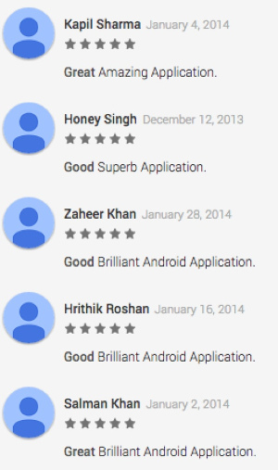
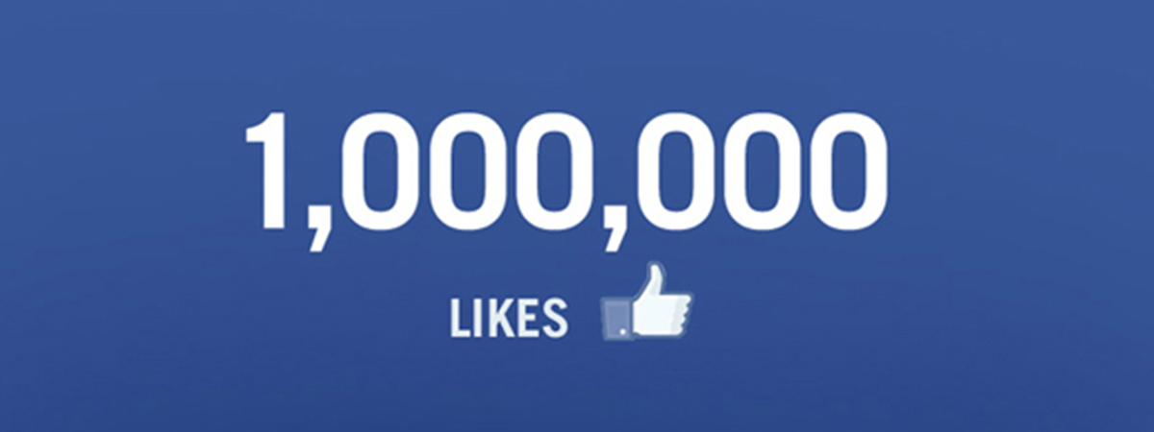
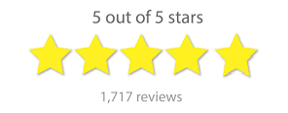
The next burning issue are the ratings on Google Play. Handwritten Text Recognition apps don’t have a good reputation amongst customers. Easy to see that there’s quite a big niche for products of that type. Since, such technology is worth developing and supporting. Here’s our big chance for the future…

Slide 17
Advantages:
Working graphical interface.
Model recognises small letters, capital letters and digits.
High accuracy of fit (due to compound training set).
Mobile applications (in testing stage).
The app works really fast.
Free to purchase.

Slide 18
Drawbacks:
problem with recognizing similar characters
inaccurate segmentation of words into single characters (we were close to implement)
no possibility to write text in GUI (also we were close to do so)

Slide 19
Conclusions:
It's hard to cooperate with teammates in real time. We have not found any tool to do this efficiently. Google Colaboratory enables team work in real time. However, we are dealing with a long delay during work. Position of team leader is really important for the effectiveness of the group's work.
Dealing with things that are new to us causes our development.

Slide 20
Summary
The project gave us a perfect opportunity to improve our skills. We’ve encountered many troubles, which were sometimes really difficult to omit. For instance, a single network training took almost 20 hours due to about 800 000 photos processed in 50 epochs each. Another challenge was organizing the group work. Google collab looked like an interesting solution, however it was a trap. Free version of this tool was insufficient for machine learning and real time actions. All in all, it was really worth to take part in such a project, as it inspired us to work more on the ML problems.

